Slide 1
Recursive algorithms
Merge sort
Solving Recurrences

Slide 2
Factorial
n!=n(n-1) (n-2) (n-3)(n-4)…(1)
5!=5*4*3*2*1=120
Iterative method
int fact(int n) {
int p=1
for (int i = n; i >=1; i--)
p=p*i;
return p;
}
Recursive method
int fact(int n) {
if (n == 1) ;
return 1 ;
else
return n*fact(n-1);
}

Slide 3



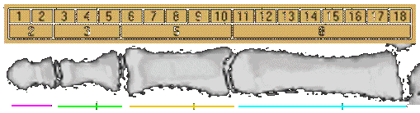
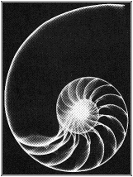
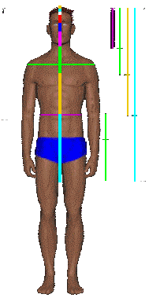
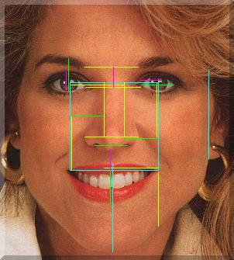

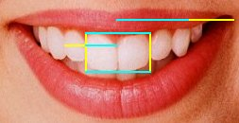
Fibonacci Numbers
1, 1, 2, 3, 5, 8, 13, 21, 34, 55, 89, 144, 233, 377, 610…
Golden ratio

Slide 4
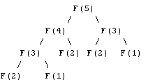
Fibonacci Numbers
1, 2, 3, 4, 5, 6, 7, 8, 9, 10, 11, 12, 13, 14, 15,…n
1, 1, 2, 3, 5, 8, 13, 21, 34, 55, 89, 144, 233, 377, 610…
int fib(int n) { //Recursive
if (n <= 2) ;
return 1 ;
else
return fib(n-1) + fib(n-2);
}
int fib(int n) { //Iterative
int f[n+1];
f[1] = f[2] = 1;
for (int i = 3; i <= n; i++)
f[i] = f[i-1] + f[i-2];
return f[n];
}

Slide 5
Merge Sort
If n<2 then the array is already sorted. Stop now.
Otherwise, n>1, and we perform the following three steps in sequence:
  Sort the left half of the array.
  Sort the right half of the array.
  Merge the now-sorted left and right halves.

Slide 6
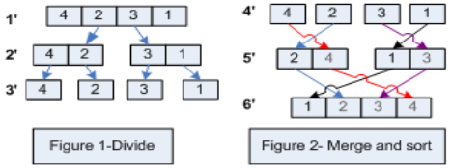
Merge Sort: Example
Show MergeSort() running on the array
A = {4, 2, 3, 1};

Slide 7
Analysis of Merge Sort
Statement Effort
T(n) = O(1) when n = 1, otherwise
T(n) = O(1)+O(1)+T(n/2) + T(n/2) + O(n)
2T(n/2) + O(n) when n > 1
So what is T(n)?
MergeSort(A, left, right) { T(n)
if (left < right) { O(1)
mid = floor((left + right) / 2); O(1)
MergeSort(A, left, mid); T(n/2)
MergeSort(A, mid+1, right); T(n/2)
Merge(A, left, mid, right); O(n)
}
}

Slide 8
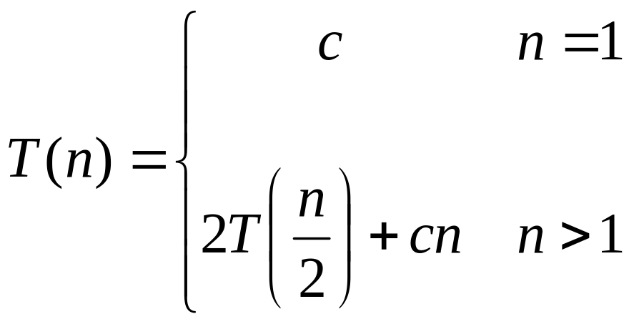
Recurrences
The expression:
is a recurrence.
  Recurrence: is an equation that describes a function in terms of its value on smaller inputs

Slide 9

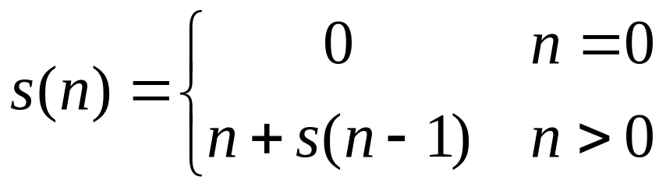
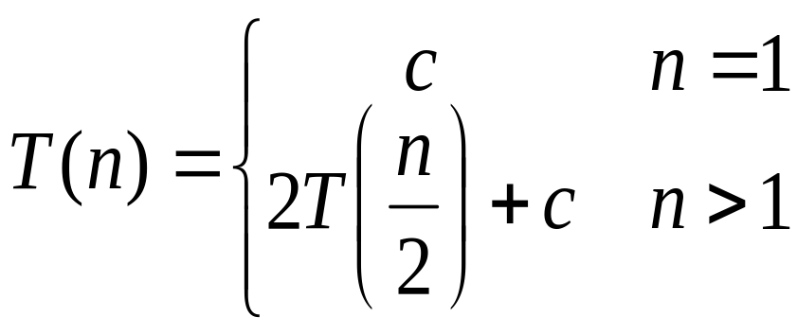
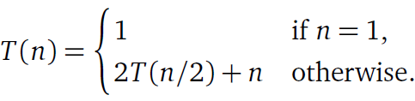
Recurrence Examples
Example 1
Example 2
Example 3
Example 4 – Merge sort

Slide 10
Solving Recurrences
A Recurrence can be solved using several methods such as: Recursion-Tree, Substitution method, the Master method and the Iteration method.
In this course we will focus on the Iteration method to solve recurrences:
  Expand the recurrence
  Work some algebra to express as a summation
  Evaluate the summation
We will show several examples

Slide 11

Example 1
s(n) =
c + s(n-1)
c + c + s(n-2)
2c + s(n-2)
2c + c + s(n-3)
3c + s(n-3)
…
kc + s(n-k) = ck + s(n-k)

Slide 12
Example 1
So far for n >= k we have
  s(n) = ck + s(n-k)
What if k = n?
  s(n) = cn + s(0) = cn
So
Thus in general
  s(n) = cn = O(n).

Slide 13
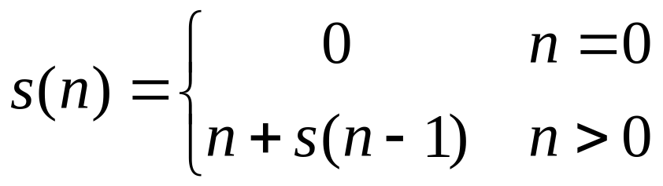
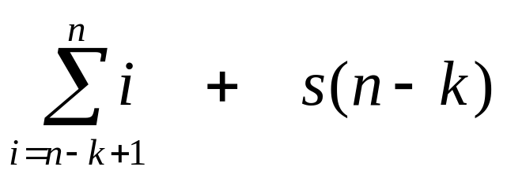
Example 2
s(n)
= n + s(n-1)
= n + n-1 + s(n-2)
= n + n-1 + n-2 + s(n-3)
= n + n-1 + n-2 + n-3 + s(n-4)
= …
= n + n-1 + n-2 + n-3 + … + n-(k-1) + s(n-k)
=

Slide 14
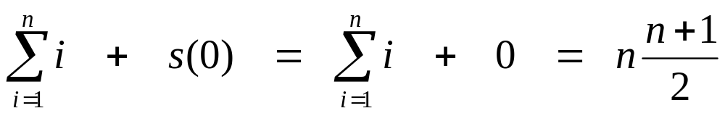
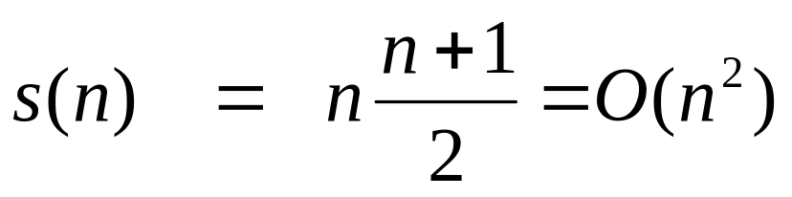
Example 2
So far for n >= k we have
What if k = n?
Thus in general

Slide 15
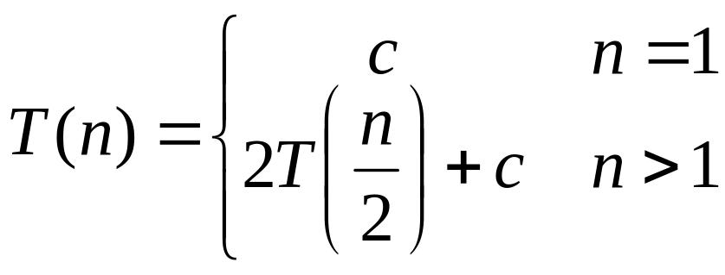
Example 3
T(n) =
2T(n/2) + c
2(2T(n/2/2) + c) + c
2²T(n/2²) + 2c + c
2²(2T(n/2²/2) + c) + 3c
2³T(n/2³) + 4c + 3c
2³T(n/2³) + 7c
2³(2T(n/2³/2) + c) + 7c
2⁴T(n/2⁴) + 15c
…
2^{k}T(n/2^{k}) + (2^{k} - 1)c

Slide 16
Example 3
So far for n > 2k we have
  T(n) = 2^{k}T(n/2^{k}) + (2^{k} - 1)c
What if k = lg n?
  T(n) = 2^{lg n} T(n/2^{lg n}) + (2^{lg n} - 1)c
  = n T(n/n) + (n - 1)c
  = n T(1) + (n-1)c
  = nc + (n-1)c = (2n - 1)c = O(n)

Slide 17
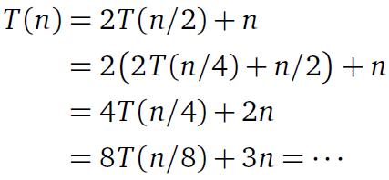


Example 4- Analysis of Merge Sort
The recurrence stops when n/2^{k} = 1, or equivalently,
when k = log₂ n:

Slide 18
Lab work - Merge Sort
void merge(long low,long mid,long high, int a[]);
void merge_sort(long low,long high, int a[] )
{
long mid;
if(low<high)
{
mid=(low+high)/2;
merge_sort(low,mid, a);
merge_sort(mid+1,high, a);
merge(low,mid,high, a);
}
}
void merge(long low,long mid,long high, int a[])
{
int *b= new int [low+high];
long h,i,j,k;
h=low;
i=low;
j=mid+1;

Slide 19
Lab work - Merge Sort ~cont
for(k=j;k<=high;k++)
{
b[i]=a[k];
i++;
}
}
else
{
for(k=h;k<=mid;k++)
{
b[i]=a[k];
i++;
}
}
for(k=low;k<=high;k++) a[k]=b[k];
delete [] b;
}
while((h<=mid)&&(j<=high))
{
if(a[h]<=a[j])
{
b[i]=a[h];
h++;
}
else
{
b[i]=a[j];
j++;
}
i++;
}
if(h>mid)
{

Slide 20
Homework 2
Program and apply the merge sort algorithm using the same parameters in the first homework, and compare the results with the previous sorting algorithms

